Slide 1
Communication Workflow — MQTT Design & Handshakes
عهدنامه و پیمان اخوت برای ارتباطات بین ماژول و سرور
15/5/1404

Slide 2
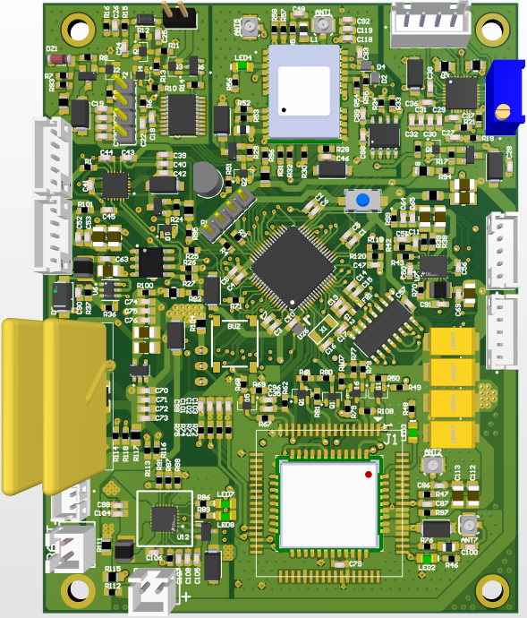
SIM7000
SIM800
GPS
RFID
RTC
Stepper
Gyroscope

Slide 3
Topic structures QoS & Reliability Configurations

Slide 4
MQTT QoS & Reliability Configurations
Feature | Choice | Reason
QoS Level | QoS 1 | Ensures delivery even with intermittent connectivity. Lightweight compared to QoS 2.
*Last Will and Testament (LWT) | No | We cannot implement it with SIM800 module
*Persistent Sessions | No | Not needed
Retained Messages | Yes on some topics | Use retained messages for static config data (e.g., latest unlock command) but NOT for status updates.
Session Expiry Interval | Set to few minutes (e.g., 5 minutes) | Gives time to reconnect and receive pending commands. Prevents broker from holding stale sessions indefinitely.

Slide 5
MQTT QoS & Reliability Configurations
MQTT Client
MQTT Broker
Publish QoS 1
QoS
1
At least once - Guaranteed delivery, but can be delivered more than once.
Needs ACK.
PUBACK

Slide 6
Topics Structure
Fleet
Fleet ID
truck
<IMEI>
status
→ Publishes GPS, timestamp, and battery level data.
rfid
→ Publishes scanned RFID tag IDs for authorization requests.
sms
→ Publishes the phone number and the lock command that it sends.
gyroscope
→ Publishes the sudden erupts or movements of the device
command
lock
→ Receives lock/unlock commands from the backend.
config
gyroscope
→ Receives configuration updates (gyroscope).
rfid
→ Receives configuration updates (RFID).
wit
→ Receives configuration updates (wake-up interval).

Slide 7
Topics Structure
Topic Type | Topic address | Notes
Status Data | truck/<IMEI>/status | Publishes timestamp, GPS data, battery level, Lock status, Temperature, RSSI, Counter and isQueued to server
RFID Scan | truck/<IMEI>/rfid | Publishes scanned timestamp, GPS, RFID tag serial number and requested action to server.
SMS Alarm | truck/<IMEI>/sms | When a user sends SMS to lock/unlock the device, a msg publishes on this topic to alert the web app
Gyroscope Alarm | truck/<IMEI>/gyroscope | When the device detects a sudden movement greater that the configured threshold, publishes alarm to the web app on this topic
Command Control - lock | truck/<IMEI>/command/lock | Server publishes unlock/lock commands here.
Command Control – Gyro config | truck/<IMEI>/command/config/gyroscope | Server publishes configuration commands for Gyroscope
Command Control – Gyro config | truck/<IMEI>/command/config/rfid | Server publishes configuration commands for RFID
Command Control – Gyro config | truck/<IMEI>/command/config/wit | Server publishes configuration commands to determine the wake-up interval.

Slide 8
Msg structures
Status, Command, RFID, LWT

Slide 9
Status Payload format
{
"time": “hour,minute,seccond",
"lat": 52.520008,
"lon": 13.404954,
“gps source”: G/B which determines if the data comes from device gps or the nearest BTS
“GPS distances traveled”: a float with one floating point digit in kilometers
“total traveled”: an int to show total traveled distance in meters
“Speed”: the speed that comes from gps, a float number with two floating point number
"battery " : 0-9, // 9 -> means 90% to 100%, 5 means 50% to 60%
" lock status" : L/U //lock/unlock
" temperature " : 27 //temperature based on Celsius
"rssi": -78, // optional but useful for diagnostics
" counter": 7 // the Nth transmission
" is queued ": 0/1 // is msg queued or not
“is in geo-fence” Y/N determines if the device is in geo-fence or not
“distance from geo-fence”: distance in meter from geo-fence
SpoffingDetected: ‘S’, ‘V’
JammingDetected: ‘J’, ‘V’
}
Truck
<IMEI>
Status
HH | MM | SS | Lat | Lon | GPS source | TraveledDist | totalTraveledDist | speed | Batt | Lock | Temp | RSSI | Cnt | Queued | isInGeo | distanceToGeo | Spoofing | Jamming
05 | 20 | 15 | 52.5 | 13.4 | G/B | 5.2 | 6.3 | 60.72 | 8 | L/U | 27 | 25 | 100 | 0/1 | Y/N | 50000 | S | J

Slide 10
Command , RFID Scan and LWT Payload
{
"time": “hour,minute,seccond",
"rfid": "E2003412010901123456789A",
“action request": L/U/N //indicates lock/unlock/Not registered
}
Truck
<IMEI>
RFID
Example messages :
“{E2003412010901123456789A, U}”
“{E2003412010901123456789A, L}”
“{E2003412010901123456789A, N}”

Slide 11
Command , RFID Scan and LWT Payload
{
"time": “hour,minute,seccond",
“phone number": “0912*********",
“action": L/U //indicates lock/unlock
}
Truck
<IMEI>
SMS
Example messages :
“{09126891656, U}”
“{09126891656, L}”

Slide 12
Command , RFID Scan and LWT Payload
{
"time": “hour,minute,seccond",
Detected_sensitivity: “value”
}
Truck
<IMEI>
gyroscope

Slide 13
Command , RFID Scan and LWT Payload
{
"time": “hour,minute,seccond",
Security_alert: R(rope cut)/B(box open)
}
Truck
<IMEI>
security

Slide 14
Lock Command Message Structure
Truck
<IMEI>
Command
{
“command”: lock_open/lock_close
}
Lock
“{lock_open}”
“{lock_close}”

Slide 15
Config Command Message Structure
Truck
<IMEI>
Command
config
{
ON/OFF
}
gyroscope
“{gyro_off}”
“{gyro_on_1}”
{
ON/OFF
}
rfid
“{off}”
“{on}”
{
#second // indicates Wake-up Interval Time
}
“{wit_on_240}”
“{wit_on_60}”
“{wit_off}”
wit
{
phone_number
}
“{add_+989126891656}”
phone_number

Slide 16
Timing intervals
GPS and network timings

Slide 17
Timing and samplings
Sampling interval
X seconds intervals GPS sampling
GPS
Wait for WIT * 2
Wait for WIT * 2
Y seconds intervals, Network connection
Network
Conn.
#1 No network failure
Queue log, set the next network retry
#2 No network failure
Queue log, set the next network retry
Reconnection Successful.
Send all queued msgs
Queue status, no connection tryout
Queue status, no connection tryout
Queue status, no connection tryout
Queue status, no connection tryout

